Slide 1
Biochemistry
Lectures for the1st and 2nd Years of medical students
Foreword by
Dr. Jamal Ahmed Abdul -Barry
(Professor of Clinical Biochemistry)

Slide 2
Biochemistry
Carbohydrate Metabolism

Slide 3
Living organism utilize glucose for
1- For deriving energy and generation of ATP.
2- The intermediate produced serve as precursors for the
synthesis of non-CHO.
Ex. Fragment produce used for synthesis of A.A and lipid.
3- Glucose is utilize to from polysaccharide, glycoprotein and
nucleic acid.
4- Formation of NADPH coenzyme , is essential as
reducing agent in the biosynthesis of F.A, steroids and DNA.

Slide 4
Digestion and absorption:
Diet contain starch , glycogen , sucrose , lactose , maltose , fructose , glucose , digested by enzyme . Other compound such as cellulose , dextran's can note be utilized due to the absence of enzyme..
In Mouth:
Starch digest by enzyme salivary amylase or ptyalin into maltose.
In Stomach:
The activity stop because of pH change to acidic into pH = 2.

Slide 5
In small intestine:
Pancreatic amylase catalyzed the random cleavage of α1-4 linkage of starch and glycogen to maltose.
Then maltose by enzyme maltase or isomaltase hydrolyze into glucose.
Surcease and lactase hydrolyzed sucrose and lactose to glucose.

Slide 6
Absorption:
From small intestine into portal circulation to the liver which is the major site for the glucose metabolism.
Blood glucose levels is control by liver, muscle, adipose tissue, hormones and enzyme.
When there is an elevation of blood glucose after glucose ingestion, the beta cells of pancreases are stimulated to secrete insulin.
This hormone decrease the amount of glucose in circulation by increase the permeability of cells to glucose.

Slide 7
Tissue depend on insulin for making glucose available are adipose tissue, skeletal muscle, diaphragm, aorta, anterior pituitary gland , lactating glands and the lens of the eye.
Other cell such as nerves, brain, R.B.C, liver do not require insulin for glucose permeability.

Slide 8
Glycolysis:
It is a series of reaction in which a glucose is degraded to pyruvic acid and lactic acid.
This process result in release of ATP and occur when in absence of Oxygen.

Slide 9
The cell is permeable to glucose, however G.6.p is impermeable in the cell membrane.
G.6.P is not highly energy phosphate compound.

Slide 10
Glucose 6.p channeled into number of metabolic pathways:

Slide 12
In the liver there is enzyme called glucokinase that catalyzed the same reaction.
The difference between HK and GK enzymes are:
1- HK has high affinity to glucose, low Km value, attack glucose although at low concentration, however GK has low affinity and high Km value acts at high level of glucose.
2- Substrate specificities.
3- Inhibitors, HK inhibited by high concentration of G.6.p .
4- HK present in all tissues include liver, GK only present in the liver.

Slide 13
Phosphofructokinase is inhibited by excess of ATP and citrate and activated by AMP and ADP.

Slide 14
The formation of FDP is the slowest of glycolytic reactions it is the
Rate limiting step used as control of glycolysis.
*This reaction is irreversible F1.6 D P can converted back to F.6.P by 1,6 fructose diphosphatase.
FDP is an important regulatory site of gluconeogenesis.

Slide 15
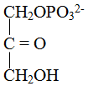
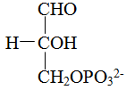

Slide 16
*This reaction is exogronic formation of high energy P. compound this reaction not occur in absence of phosphate, however, oxidation can occur when phosphate is replaced by arsenate, but next transformation is not formed.
*This is the first reaction yield ATP give ( 2mole of ATP).
.

Slide 17
This reaction required Mg+2 and is inhibited by
fluoride, which form Mg-F-phosphate complex that
prevents Mg+2 for binding to the enzyme.
*Phosphoenol pyruvate is of high energy compound.

Slide 18
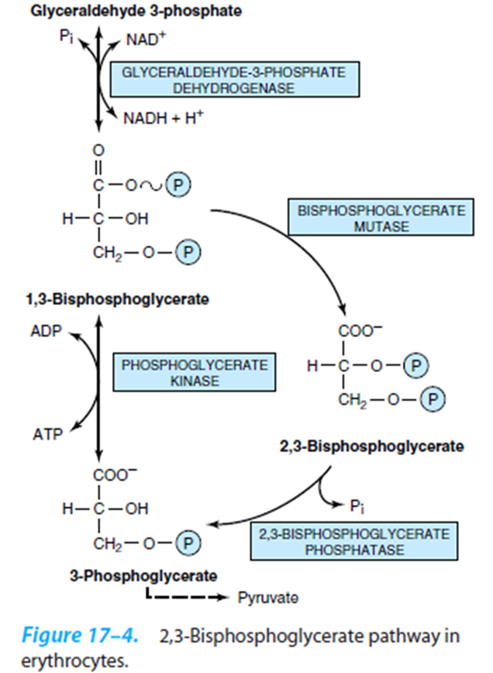

Slide 19
This bypass is serve to provide 2,3-Biphospho- glycerate, which bind to hemoglobin decreasing its affinity for oxygen, and so making oxygen more readily available to tissues.
Its important for neonates and high altitude.

Slide 20
This is a second reaction generate ATP 2mole of ATP
* In reaction 6 the reduce NADH is formed, and at this stage its used to generated NAD+, there for NAD+ is recycled in anaerobic.
In muscle lactate is formed and can not be metabolized further.
It diffusible, move to the blood then taken by the liver which converted to pyruvate then glucose by gluconeogenesis. This is the Cori cycle.

Slide 22
Regulatory Enzymes:
1. HK = Hexokinase.
2.PFK = Phosphofructokinase.
3.PK = Pyruvate Kinase.

Slide 23
From glucose to lactate.
The amount of energy produce is 4mole of ATP - 2mole
of ATP at reaction 1, and 3.
The net energy = 2 mole of ATP.
This is the net energy produce in an aerobic = 2 mole of ATP.

Slide 24
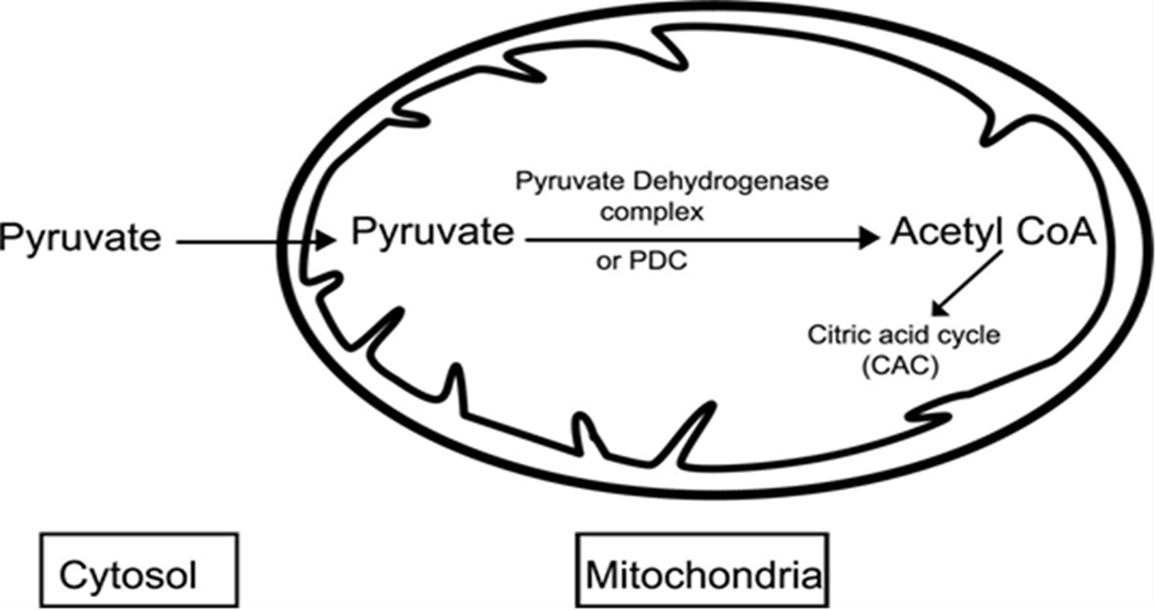
In order for pyruvate to be used for lipid synthesis, it must first transferred to mitochondria, where it is converted to acetyl CoA.

Slide 25
The NADH can be oxidized by mitochondrial NADH
dehydrogenase in Respiratory Chain and yield 3mole
of ATP X 2.

Slide 26
Pyruvate may be metabolize into
1. Lactate.
2. Alanine.
3. Oxaloacetate.
4. Malate.
5. Acetyl CoA SH.

Slide 27
Fate of pyruvate or pyruvic acid, the end product of Aerobic glycolysis are:
1.Conversion to lactate (lactic acid) by Lactate dehydrogenase (LDH) and NADH in anaerobic glycolysis.
2. Conversion to alanine (Ala).This occurs in reversible transamination reactions of amino acids metabolism.
3. Conversion to acetyl CoA.

Slide 28
Aerobic oxidation of glucose:
In the presence of oxygen, pyruvate metabolize to acetyl CoA, pyruvate acetyl CoA, reaction 12.
Then Acetyl CoA react with oxaloacetate via citric acid cycle.
When Oxygen not a limiting factor (not low) .
NADH formed in glycolysis oxidize by R. Chain.
But the cell membrane is not permeable to NADH.
So indirect route or shuttle system.

Slide 29
Shuttle system:
a- Glycerol phosphate dehydrogenase:
This is one of mechanism by which electrons from extra mitochondrial NADH transfer into mitochondria in muscle.

Slide 30
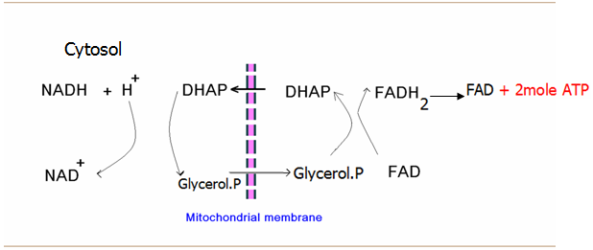
When glycerol-P pass cross the mitochondrial membrane it is oxidize by flavoprotein enzyme to DHAP.
Then the flavoprotein reoxidized in R.chain to generate 2mole of ATP.

Slide 31
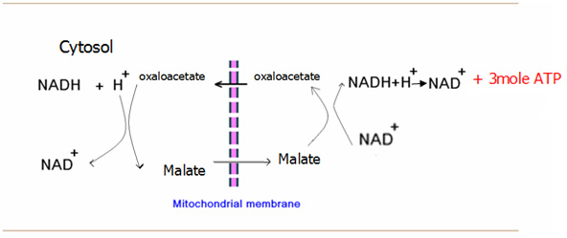
In the liver there is
b- Malate shuttle:

Slide 32
Mitochondria transfer malate but not oxaloacetate, so this system could not act as a cycle.
And as oxaloacetate depleted from the cytosol the shuttle would come to stop.
Another routes for transfer Oxaloacetate, which is either
1.Transamination.
2. Citrate-clevag enzyme.
3. Maleic enzyme.

Slide 33
Energy of glucose metabolism:
1-Anaerobic: Glucose pyruvate lactate 2mole ATP
2- Aerobic (When oxygen is not a limiting factor).
Pyruvate acetyl CoA 3mole of ATP or 6mole/mole of
glucose.
acetyl CoA CO2+ H2O 12mole of ATP or 24 mole.
2 + 24 + 6 = 32mole of ATP + 4mole of ATP from
glycerol-P shuttle or
6 mole from malate shuttle So
total amount of energy either 36 or 38mole.
d

Slide 34
Citric acid cycle: Also known as Krebs cycle or tricarboxylic acid cycle, consist of series of reactions in which the acetate component in a Acetyl CoA is degraded to CO +H O . It is oxygen dependent and not occur under an aerobic conditions.
High levels of NADH inhibit the enzymes.
The enzyme aconitase catalyze the both reaction , the removal and addition of water.

Slide 35
3-oxidation of isocitrate to α-ketoglutarate by
isocitratedehydrogenase.
Multi enzyme system called α.K.glutarate dehydrogenase.

Slide 36
The source of acetate of acetyl CoA is derived from
1.Fattyacid.
2. Pyruvate.
3.Amino acid.

Slide 37
Krebs cycle

Slide 38
Inhibitors of C. A. C
1-Fluoroacetate:
Inhibit the enzyme aconitase that catalyzes the reaction.
Citrate ↔ cis-aconitate.
2-Aresenite
Inhibit the enzyme α-ketoglutarate dehydrogenase complex. Which catalyzes the following reaction.
α-ketoglutarate -----→ SuccinylCoA.
3-Malonate:
Inhibit the enzyme succinate dehydrogenase which catalyzes the reaction.
Succinate ↔ fumarate.

Slide 39
Vitamins play a role in C.A.C
1-Riboflavin: In(FAD) ,Is a cofactor for succinate dehydrogenase.
2-Niacin:(NAD) , The electron acceptor isocitrate
dehydrogenase, α-ketoglutarate dehydrogenase,
and malate dehydrogenase.
3-Thiamin: (vit. B₁) as coenzyme for decarboxylation in the α-ketoglutaratedehydrogenase reaction.
4-Pantothenic acid: As apart of coenzyme A , such as
acetyl-CoA , and Succinyl CoA.

Slide 40
The role of metals in C.A.C.
1-Fe⁺2 :
Cofactor of aconitase enzyme.
2- Mg⁺2:
As cofactor for succinate thiokinase.
3-Mn⁺2:
For isocitrate dehydrogenase.

Slide 41
Regulation of C.A.C
It depends primarily on a supply of oxidized cofactors NAD⁺ because of the tight coupling between oxidation and phosphorylation dependent on the availability of ADP and hence,
ultimately on the rate of utilization of ATP in chemical and physical work, in addition, individual enzymes of cycle are regulated.

Slide 42
The most likely sites for regulation are the non-equilibrium reactions catalyzed by pyruvate dehydrogenase , citrate synthase, isocitratedehydrogenase , and α-ketoglutarate dehydrogenase.
The dehydrogenases are activated by Calcium ion.
Which is increased by the increasing of muscle demand.
In a tissue such as brain , whichs largely depend on CHO to supply of acetyl-CoA., control of C.A.C. may occur at pyruvate dehydrogenase.

Slide 43
Role of C.A.C. and fatty acid synthesis.

Slide 44
Regulation of pyruvate dehydrogenase :
Pyruvate dehydrogenase inhibited by its product Acetyl CoA and NADH thus in starvation when FFA concentration increase there is decrease in the production of enzymes.
Inhibition of pyruvate metabolism leads to lactic acidosis
1. As, Hg, complex to the ---SH group of lipoic acid and inhibited LDH.
2. Dietary deficiency of thiamin leads to accumulate pyruvate.
3. Alcoholic are thiamin deficient in given glucose load rapid accumulation of pyruvate and lactic acidosis.

Slide 45
Glycogen metabolism :
It is the major storage form of CHO in animals, it occurs mainly in liver 6% and in muscle 1%.
Glycogen biosynthesis:

Slide 46
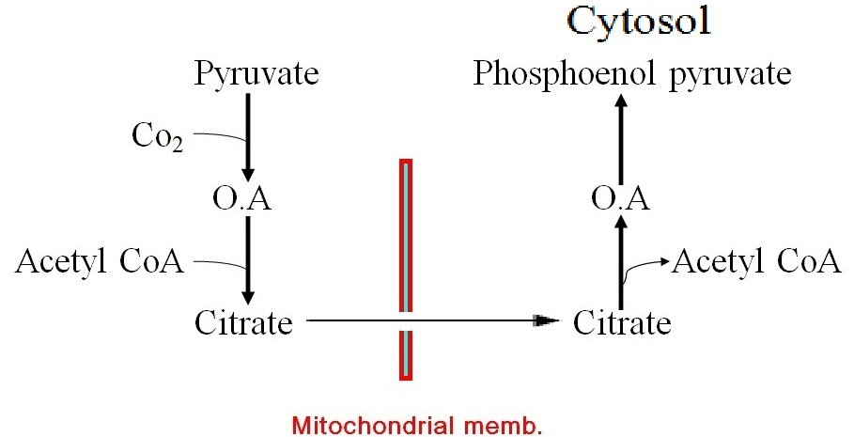
2. Citrate lyase:

Slide 47
Thank You

